Slide 1
Wi-Fi Traffic Monitoring System

Slide 2
Wi-Fi Traffic Monitoring System
Notes:
- First chapter we learned different components of network ( nut and bolt of network )
- Second chapter we covered Network Protocol
- Third chapter we will cover a very important layer in network ( Network Layer ) from SDN point of view

Slide 3
Understand the fundamental principles of local WiFi network traffic
Learn a practical method for capturing and analyzing data packets
Explore how traffic monitoring can be used for performance analysis, security, and general network insights
Introduction
Lab setup
Dashboard and observation
Advance suggestions
Notes:
Hello, Anyohasye, Namaste
This is Prof Suman Pandey from EECS department GIST
We are learning Advanced Computer Networking
We are now in third modeul
Focusing on SDN archtesure
We learning about Generalized forwarding in prevous module
This module we focus on control plane

Slide 4
Introduction
Wi-Fi Traffic Monitoring
Notes:
- First chapter we learned different components of network ( nut and bolt of network )
- Second chapter we covered Network Protocol
- Third chapter we will cover a very important layer in network ( Network Layer ) from SDN point of view

Slide 5
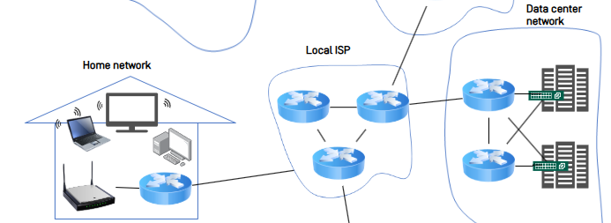
What is Wi-Fi Traffic and Why Monitor it?
What is Wi-Fi Traffic?
The flow of data packets between your devices and the router.
It's the invisible conversation happening on your network.
Why monitor it?
Security: Detect threats & unauthorized devices.
Performance: Find bottlenecks & manage bandwidth.
Troubleshooting: Diagnose connection issues.
source
Re-created illustration

Slide 6
What is a packet? Anatomy of a Data Packet
Every piece of data is sent in a packet, which is like a digital envelop. Each packet has three main parts:
1. Header (The “Mailing Label”)
Contains all the control information for delivery.
Source & Destination Addresses / Protocol / Port Number
2. Payload (The “Letter”)
This is the actual data packets are delivering.
It could be a piece of an email, part of a website, or a second of video.
3. Trailer (The “Seal of Integrity”)
Marks the end of the packet and contains error-checking information.
Frame Check Sequence (FCS): Verifies that the data arrived without being corrupted.

Slide 7


The Central Role of the Router
The Router: Network’s Gateway
The router is the single gateway for all network traffic
All data packets must pass through it, making it the ideal monitoring point.
Our system uses a standard home/office router-no special hardware needed
Router

Slide 8


Core Concepts: How We Capture Traffic
Port Forwarding / Mirroring
A router feature that duplicates all traffic and sends a copy to our monitoring device.
Packet Sniffing
Software on our monitoring device (e.g. Wireshark) that captures and records the copied packets for analysis.
Internet
Router
Packet Capture

Slide 9
The Problem: Limitations of Commercial Routers
Closed Systems
Most commercial routers run vendor-specific OS, making it difficult to install custom software.
Solution: A Mini-PC as a Network “Checkpoint”
Use a Linux-based Mini-PC to act as a transparent router
It sits between your internet source and the existing Wi-Fi router, inspecting all incoming and outgoing traffic
Internet
Router
A Transparent Router Mini-PC

Slide 10
Foundations of Packet Capture
OSI Layers & Capture Points
Application
Presentation
Session
Transport
Network
Data Link
Physical
Application Layer
This is the actual data being sent. (content of a website or a message)
Network & Transport Layers ( <- Scapy’s Primary Domain)
It contains the packet’s IP address and port number.
Scapy are designed to read and manipulate this critical information.
Data Link Layer ( <- Raw Socket Access)
This is the lowest level we can access.
We capture the raw, complete data packet directly from the physical network hardware.

Slide 11
Our Project’s Capture Stack & Configuration
Library Stack
System Layer: libpcap (Provides low-level access to the network interface)
Python Binding: Scapy 2.5.0 (Powerful packet manipulation library)
Application layer: PacketCapture Class (Our custom implementation)
Default Configuration
Interface: enp2s0 (Example)
Capture Mode: standard (Normal Mode)
BPF Filter: “net 192.162.100.0/24 or not arp and not icmp6” (Example)
Captures traffic to or from the 192.168.100.x network, ignoring noisy ARP and ICMPv6 packets.
Buffer Size: 65,535 bytes (To capture max-sized packets)

Slide 12
Summary
Why Monitor Traffic?
We monitor the flow of data packets on a network to enhance security, improve performance, and troubleshoot issues.
Our Approach
Since commercial routers are closed systems, we use a Mini-PC as a transparent router to intercept and analyze all traffic
Method
This setup allows us to duplicate (Mirroring) and capture (Sniffing) packets for detailed analysis.

Slide 13
Preliminaries
2. Scapy
Notes:
- First chapter we learned different components of network ( nut and bolt of network )
- Second chapter we covered Network Protocol
- Third chapter we will cover a very important layer in network ( Network Layer ) from SDN point of view

Slide 14

Why Scapy for the Project?
What is Scapy?
Scapy is a powerful Python library for packet manipulation. It can forge, send, sniff, and dissect packets.
Why Not Other Tools (like Wireshark or tcpdump)?
1. Seamless Python Integration
2. Real-time, Programmatic Control
3. High-Level Syntax for Low-Level Data

Slide 15
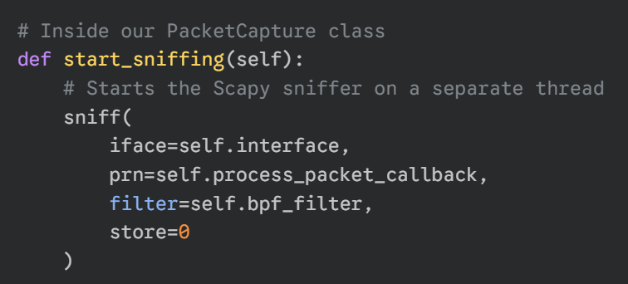
The Code: How We Capture with sniff()
The sniff() Function
Packet capture is intiated with Scapy’s sniff() function. We’ve wrapped this in our own PacketCapture class for control.
Here is a sample code that starts the capture:

Slide 16
The Code: How We Process Packets
The process_packet Callback
This is the function that Scapy calls for every packet. It’s where our main logic lives.
It follows these 4 steps:
1. Filter (Check for IP)
2. Parse (Extract Data with Scapy)
3. Format (Prepare for DB)
4. Save (Send to MongoDB)

Slide 17
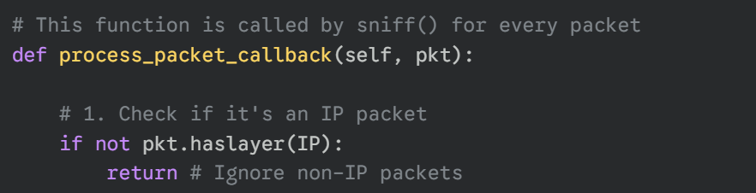
The Code: How We Process Packets
1st Step: Filter (Check for IP)
This filtering reduces unnecessary processing.
The database only stores relevant network information.

Slide 18
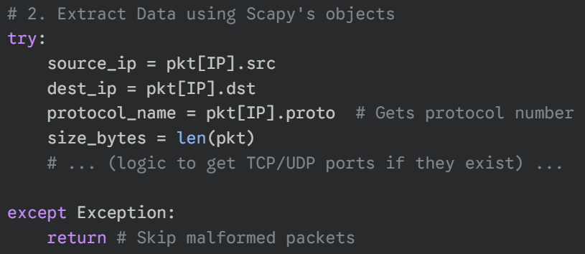
The Code: How We Process Packets
2nd Step: Parse (Extract Data with Scapy)

Slide 19
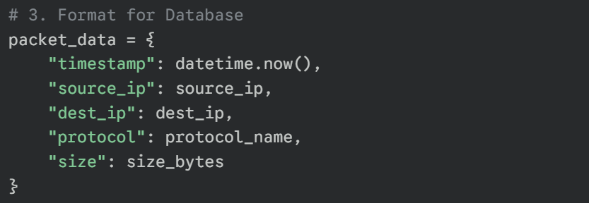
The Code: How We Process Packets
3rd Step: Format (Prepare for DB)
4th Step: Save (Send to MongoDB)

Slide 20
Preliminaries
2. MongoDB
Notes:
- First chapter we learned different components of network ( nut and bolt of network )
- Second chapter we covered Network Protocol
- Third chapter we will cover a very important layer in network ( Network Layer ) from SDN point of view

Slide 21

What is MongoDB?
MongoDB is a modern type of database known as a NoSQL database.
Unlike traditional databases that use tables with rows and columns (like an Excel spreadsheet), MongoDB stores in a more flexible format.
In uses JSON-like documents, which allows it to store complex data structures easily and naturally.
source
Re-created illustration

Slide 22
Core Concepts: Documents & Collections
Documents
The basic unit of data in MongoDB.
A document is a set of field-and-value pairs, very similar to a JSON object.
Example: { “source_ip”: “192.168.1.10”, “protocol”: “TCP”, “size”: 64 }
Collections
A group of documents.
This is similar to a table in a traditional database.
However, a single collection can hold documents with different structures.
source
Re-created illustration

Slide 23
Key Advantage: Schemaless Flexibility
The most significant advantage for our project is that MongoDB is schemaless.
This means that documents within the same collection do not need to have the same fields or structure.
Why is this important for us?
Network packets are not all the same. A TCP packet has different information than a UDP packet.
MongoDB allows us to store all these different types of packets in the same packet collection without any issues.
source
Re-created illustration

Slide 24
Why MongoDB for This Project?
We chose MongoDB for the traffic monitoring system for two main reasons:
High Performance
The system needs to capture and save thousands of packets per second. MongoDB is designed to handle this high volume of write operations very quickly and efficiently.
Scalability
As we capture more and more network traffic, our database will grow very large. MongoDB an easily scale across multiple servers to handle massive amounts of data without slowing down.
source
Re-created illustration

Slide 25
Lab Setup
Notes:
- First chapter we learned different components of network ( nut and bolt of network )
- Second chapter we covered Network Protocol
- Third chapter we will cover a very important layer in network ( Network Layer ) from SDN point of view

Slide 26
Prerequisites
This lab is designed to run in a Linux-based environment (e.g., Ubuntu, etc.)
Install: python3-pip, nginx, hostapd, dnsmasq, iptables-persistent
Python: The core programming language for our capture scripts.
pip: The package installer for managing Python libraries (e.g., Scapy, Pymongo).
MongoDB: A NoSQL database used to store and query captured packet data.
Nginx: A lightweight web server for hosting the analysis dashboard.

Slide 27
Step 1: MongoDB
1. Import the MongoDB GPG Key
curl -fsSL https://pgp.mongodb.com/server-7.0.asc | sudo gpg -o /usr/share/keyrings/mongodb-server-7.0.gpg --dearmor
2. Add the MongoDB Repository
echo "deb [ arch=amd64,arm64 signed-by=/usr/share/keyrings/mongodb-server-7.0.gpg ] https://repo.mongodb.org/apt/ubuntu $(lsb_release -cs)/mongodb-org/7.0 multiverse" | sudo tee /etc/apt/sources.list.d/mongodb-org-7.0.list

Slide 28
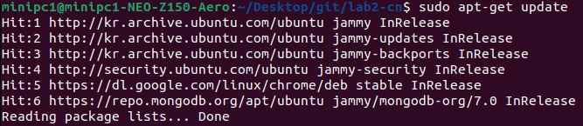
Step 2: Install
3. Update Local Package List
sudo apt-get update
4. Install All Required Packages
sudo apt-get install -y python3-pip mongodb-org nginx hostapd dnsmasq iptables-persistent

Slide 29
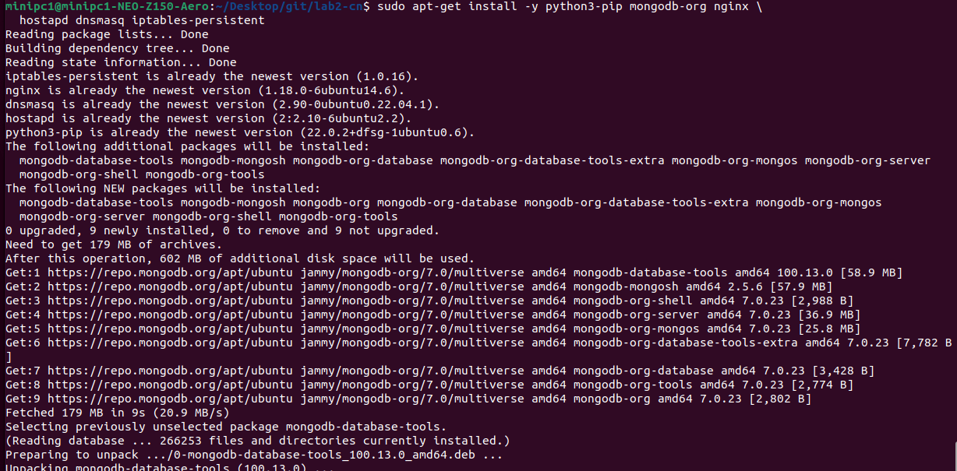
Step 2: MongoDB

Slide 30

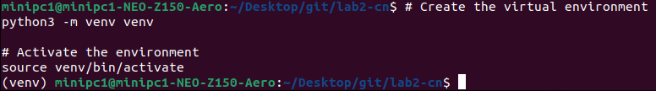
Step 3: Python Virtual Env.
1. Install python3-venv
sudo apt-get install –y python3-venv
2. Create & Activate the Environment
Python3 –m venv venv
Source venv/bin/activate
Virtual Env. is activated.

Slide 31
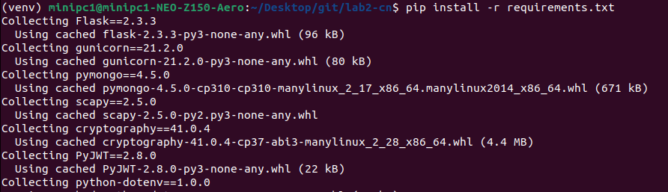
Step 3: Python Virtual Env.
With the virtual env. active, install all the required Python libraries (like Flask, Scapy, etc.) using the requirements.txt file
3. Install Python Dependencies
pip install -r requirements.txt

Slide 32

Step 4: Start & Enable MongoDB
1. Start and Enable the Service
sudo systemctl start mongod
sudo systemctl enable mongod

Slide 33
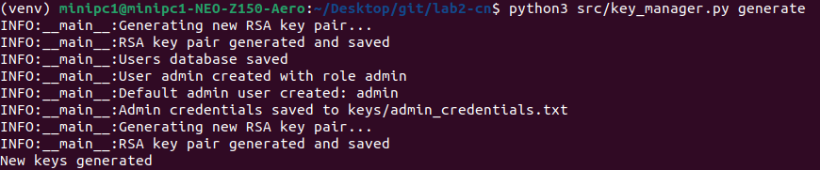
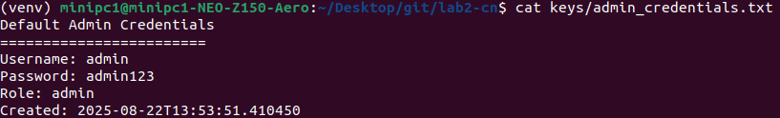
Step 5: Generate Keys
1. Generate Security Key & Admin Account
python3 src/key_manager.py generate
2. Check Password
cat keys/admin_credentials.txt

Slide 34
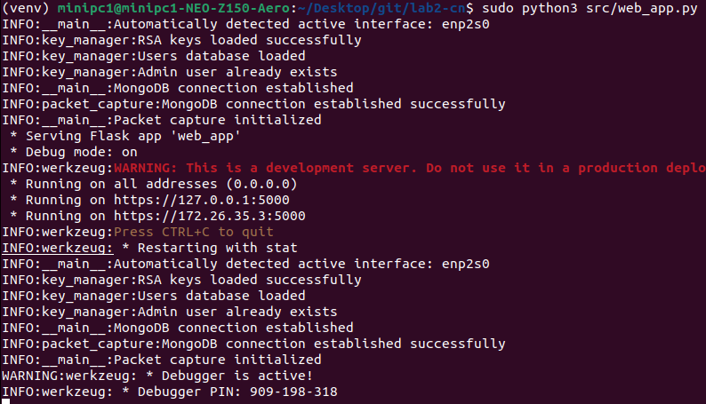
Step 6: Run Application
1. Run the Web Application
sudo python3 src/web_app.py
Ctrl+{Click}

Slide 35
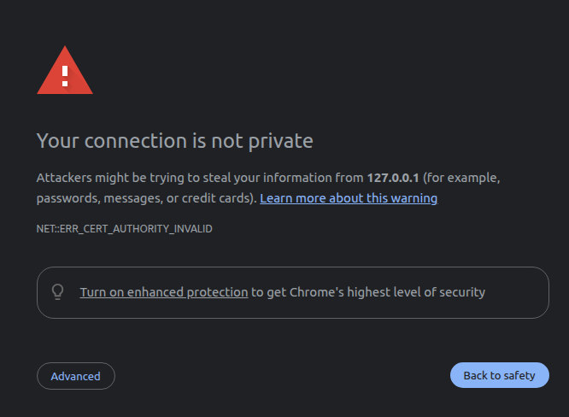
Step 6: Access to the Webpage
1. Run the Web Application
Click

Slide 36
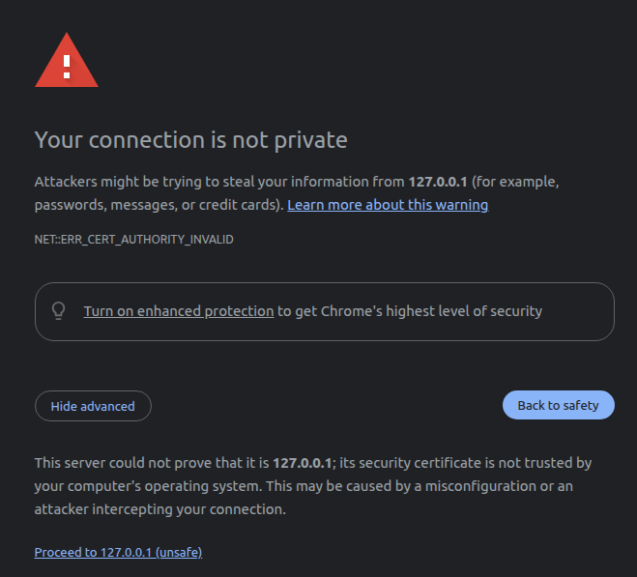
Step 6: Access to the Webpage
Click

Slide 37
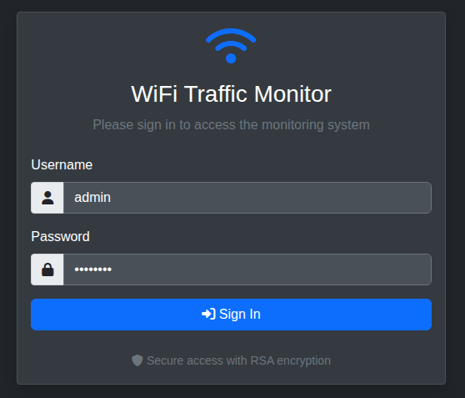
Step 6: Access to the Webpage
1. Log in with Username & Password
Username: admin
Password: admin123
Now, let’s dive into the detailed features of the tool and how to use them in next section.

Slide 38
Dashboard and Observation
Notes:
- First chapter we learned different components of network ( nut and bolt of network )
- Second chapter we covered Network Protocol
- Third chapter we will cover a very important layer in network ( Network Layer ) from SDN point of view

Slide 39

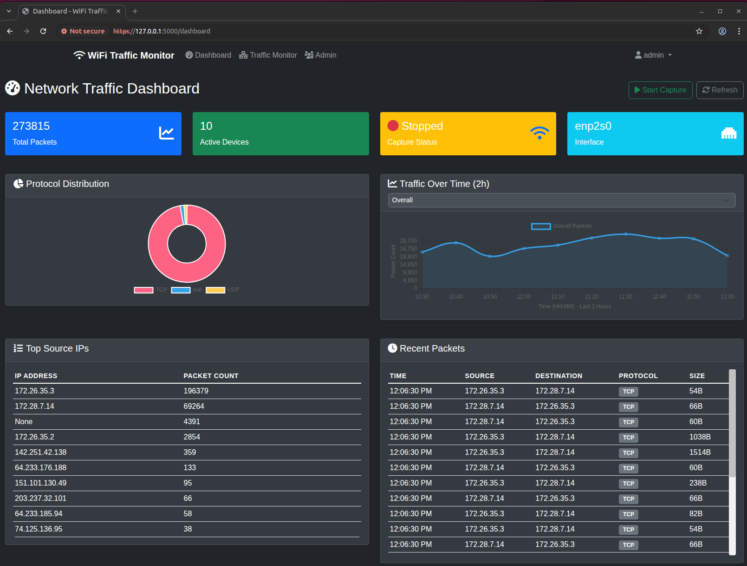
Dashboard Overview: Visualizing Network Traffic
Start Button for
Packet Capturing
Menu
Main Contents of Dashboard

Slide 40
Three Key Features: A Quick Tour
Dashboard
A visual summary page to understand the network’s overall status and traffic patterns at a glance through graphs and charts.
Traffic Monitor
A detailed investigation tool to troubleshoot network issues by searching and analyzing specific packets with filtering.
Admin Panel
An admin-only page to control user access and manage the system’s overall status and security.

Slide 41
Dashboard and Observation
- Dashboard -
Notes:
- First chapter we learned different components of network ( nut and bolt of network )
- Second chapter we covered Network Protocol
- Third chapter we will cover a very important layer in network ( Network Layer ) from SDN point of view

Slide 42
A Snapshot of Network’s Health
The top panel offers a real-time summary of the network’s critical information
Total Packets
The cumulative count of all captured packets.
Active Devices
Shows the number of unique devices currently sending or receiving data.
Capture Status & Interface
Clearly indicates if the monitoring system is currently running (Status) and which network card (interface) is being monitored.

Slide 43
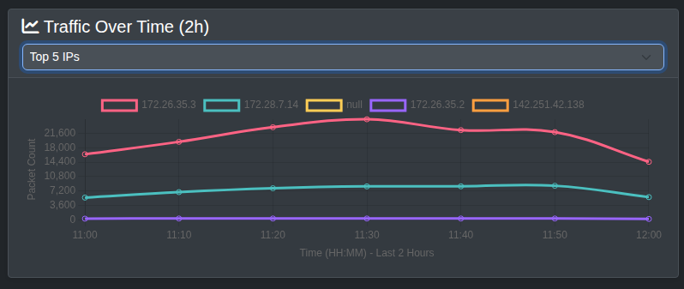
Traffic Patterns: What Kind and When?
Protocol Distribution
This donut chart shows the proportion of different protocols, like TCP and UDP.
It helps you understand the primary purpose of the network’s usage, whether it’s for web browsing (TCP) or for video streaming and gaming (UDP).
Traffic Over Time
This line graph displays the trend of traffic volume over a specific period.
It’s essential for identifying the network’s busiest periods and spotting anomalies, such as sudden and unexpected traffic spikes.

Slide 44
Detailed Analysis: Who is Talking and What Are They Saying?
Top Source Ips
This table ranks the IP addresses that have generated the most packets on the network.
It allows you to identify which devices are consuming the most bandwidth.
Recent Packets
A real-time log of captured packets, displayed chronologically with details like source, destination, protocol, and size.
This provides the most granular and specific data.

Slide 45
Dashboard and Observation
- Traffic Monitor -
Notes:
- First chapter we learned different components of network ( nut and bolt of network )
- Second chapter we covered Network Protocol
- Third chapter we will cover a very important layer in network ( Network Layer ) from SDN point of view

Slide 46
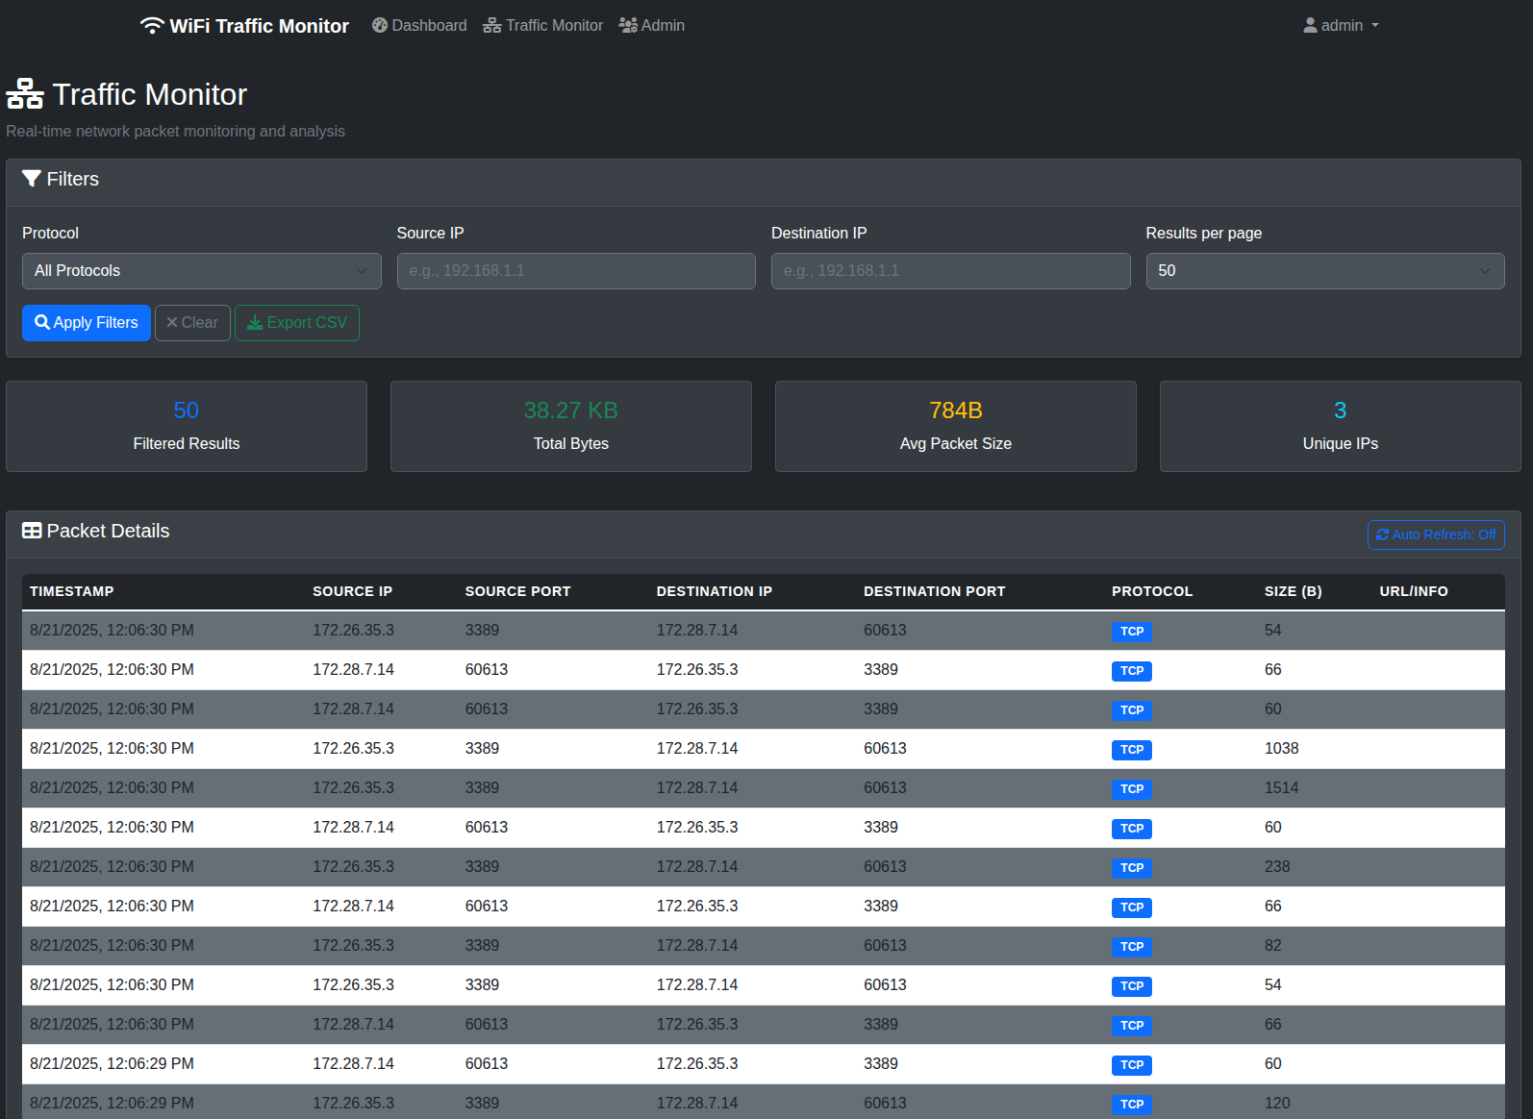
Traffic Monitor: Deep Packet Inspection
The Traffic Monitor page is an interactive tool for detailed, real-time analysis of captured packets.
Unlike the main dashboard which provides a summary, this view allows you to filter, search, and drill down into specific network conversations for in-depth investigation and troubleshooting.

Slide 47
Traffic Monitor: Deep Packet Inspection
Filters:
Allows you to pinpoint specific data flows.
You can search by Protocol, Source IP, and Destination IP.
Exporting:
Enables offline analysis and reporting.
The “Export CSV” feature allows you to save your filtered results, making it easy to share data or perform further analysis in other tools like Excel.

Slide 48
Dashboard and Observation
- Admin Panel -
Notes:
- First chapter we learned different components of network ( nut and bolt of network )
- Second chapter we covered Network Protocol
- Third chapter we will cover a very important layer in network ( Network Layer ) from SDN point of view

Slide 49
Traffic Monitor: Deep Packet Inspection
The Traffic Monitor page is an interactive tool for detailed, real-time analysis of captured packets.
Unlike the main dashboard which provides a summary, this view allows you to filter, search, and drill down into specific network conversations for in-depth investigation and troubleshooting.

Slide 50
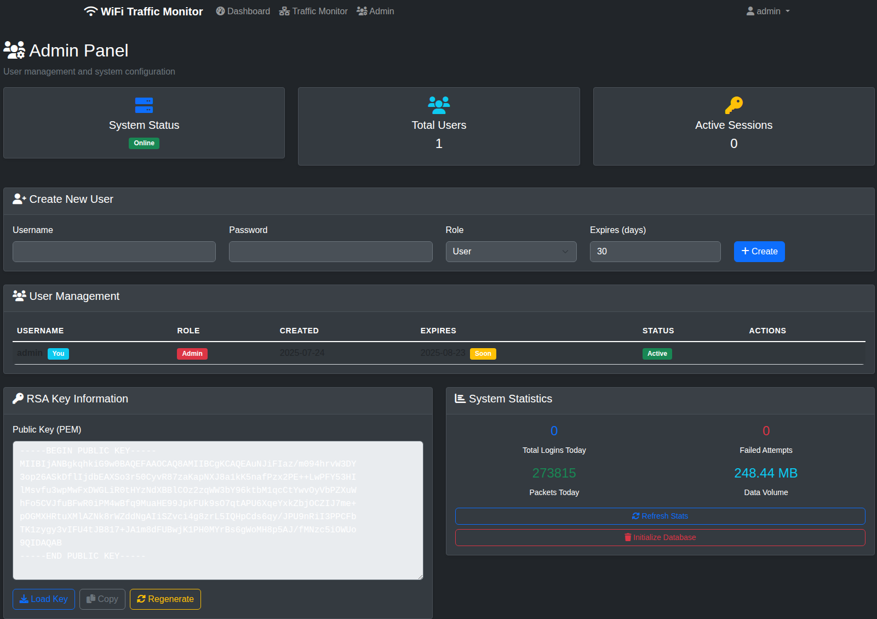
Admin Panel – System & User Management
The Admin Panel is the central hub for system configuration and security, separate from the traffic analysis dashboard.

Slide 51
Traffic Monitor: Deep Packet Inspection
Create New User:
Allows the administrator to create new user accounts.
You can define a Username, Password, assign a Role and set an expiration date for the account.
User Management Table:
Provides a comprehensive list of all existing users.

Slide 52
Traffic Monitor: Deep Packet Inspection
RSA Key Information:
Manages the public key for secure communication.
This is an advanced security feature, likely used to secure API connections or ensure encrypted communication between monitoring components.
System Statistics:
Offer a high-level overview of the system’s health.
You can quickly see the online status and statistics of the system.
You can also initialize the database.

Slide 53
Advanced Suggestion
Intelligent Network Monitoring
Notes:
- First chapter we learned different components of network ( nut and bolt of network )
- Second chapter we covered Network Protocol
- Third chapter we will cover a very important layer in network ( Network Layer ) from SDN point of view

Slide 54
Future Enhancements: Intelligent Network Monitoring with AI & LLM
Our current system provides a robust foundation for advanced network analysis.
By integrating AI and Large Language Models (LLMs), we can unlock powerful new capabilities.
1. Intelligent Threat Detection
Anomaly Detection
Proactive Defense
2. Content-Based Filtering & Blocking
Harmful Website Detection
Time-Based Access Control
3. Predictive Network Management
Bandwidth Prediction
Automated Troubleshooting
4. Enhanced Network Insights & Reporting
User Behavior Analysis
Natural Language Reporting

